Slide 1






Group 4 | BUAN 6312.001
DO MANDATORY SEAT BELT LAWS
SAVE LIVES?
An Econometric Analysis of Traffic Fatalities
Likith Rajashekar | Muni Rohith Laisetty | Unmona Das | Niral Devang Shah | Jeremy Adam Duchin | Satyajeet Reddy Mittakanti

Slide 2

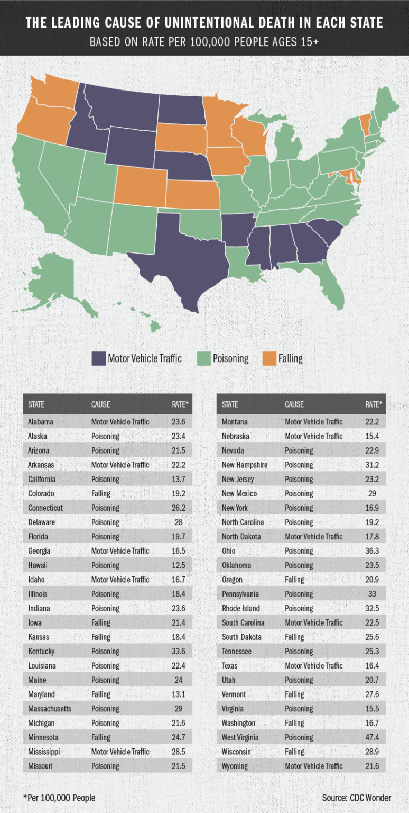
INTRODUCTION
MOTIVATION: WHY THIS TOPIC MATTERS
Motor‑vehicle crashes remain a leading cause of premature mortality in the United States.
Observational studies suggest that wearing a seatbelt dramatically increases the odds of surviving a crash.
To answer our question, we exploit the staggered adoption of two enforcement regimes—
Secondary (citation issued only after another traffic offense)
Primary (citation issued solely for belt non‑use).

Slide 3

SOURCE: US SEATBELTS PANEL FROM THE AER R
PACKAGE, 1983–1997, STATE‐YEAR OBSERVATIONS.
KEY VARIABLES:
fatalities – deaths per 100 million vehicle‑miles.
seatbelt – rate of occupants wearing belts.
enforce – no, secondary, or primary enforcement.
income – real per‑capita personal income.
alcohol, speed65, drinkage – dummies for open‑container, 65 mph limit, and minimum‑legal‑drinking‑age ≥ 21.
SAMPLES:
Secondary‐law states: 457 state-years (23 states adopted)
Primary‐law states: 87 state-years (9 states adopted)
WHAT KIND OF DATA WAS INVOLVED?

Slide 4
METHODOLOGY
CHALLENGES
WHY NAÏVE OLS FAILS :
RISK‐PREFERENCE BIAS: SAFE AND CAUTIOUS DRIVERS ARE OVER-REPRESENTED AMONG BELT WEARERS.
REVERSE CAUSALITY: STATES REACT TO INCREASING FATALITIES BY TIGHTENING LAWS.
OMITTED VARIABLES: ROAD IMPROVEMENTS OR CAMPAIGNS COINCIDE WITH ENFORCEMENT.
IDEAL EXPERIMENT :
RANDOMLY ASSIGN ENFORCEMENT OR BELT USE—IMPOSSIBLE IN PRACTICE—SO WE USE POLICY CHANGES AS A PROXY “EXPERIMENT.”
APPROACH
2SLS APPROACH
START WITH MODELING AN EQUATION WITH NATURAL OBSERVED LOG OF SEATBELT USAGE
WE THEN RELATE THE FIRST EQUATION WITH THE LOG OF FATALITY PER 100 MILLION MILES
EQUATION
FIRST STAGE: LOG(SEATBELTᵢₜ) = Α + Π₁ SECONDARYᵢₜ + Π₂ PRIMARYᵢₜ + ΓXᵢₜ + Δᵢ + Λₜ + Εᵢₜ
SECOND STAGE: LOG(FATALITIESᵢₜ) = Β * LOG(SEATBELT̂ᵢₜ) + ΘXᵢₜ + Δᵢ + Λₜ + Ηᵢₜ

Slide 5

What are the identification assumptions that must hold?
Relevance
Changes in enforcement laws (secondary or primary) must significantly predict variation in seatbelt usage across states and years.
Supported by strong first-stage F-statistics.
Exclusion Restriction
After controlling for state and year fixed effects and other covariates, the enforcement type must influence traffic fatalities only through its effect on seatbelt usage—not through other concurrent safety measures (e.g., DUI campaigns).
Monotonicity
The policy shift to stronger enforcement cannot lead any group to reduce seatbelt use (i.e., no “defiers”).
ASSUMPTIONS

Slide 6
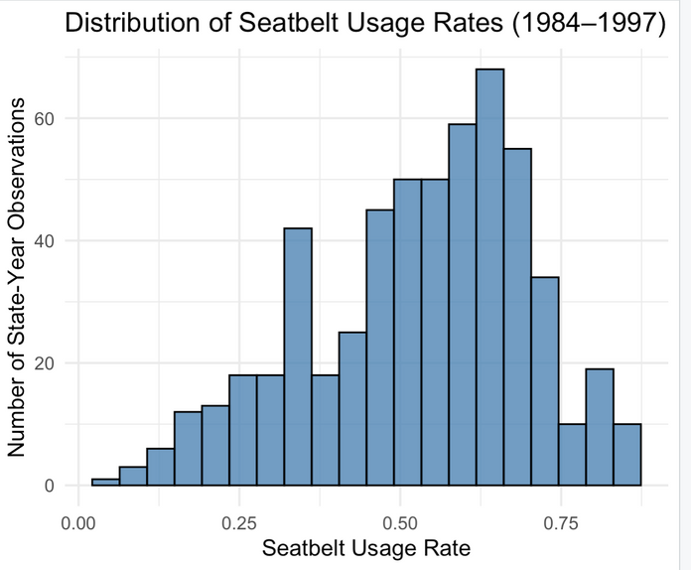
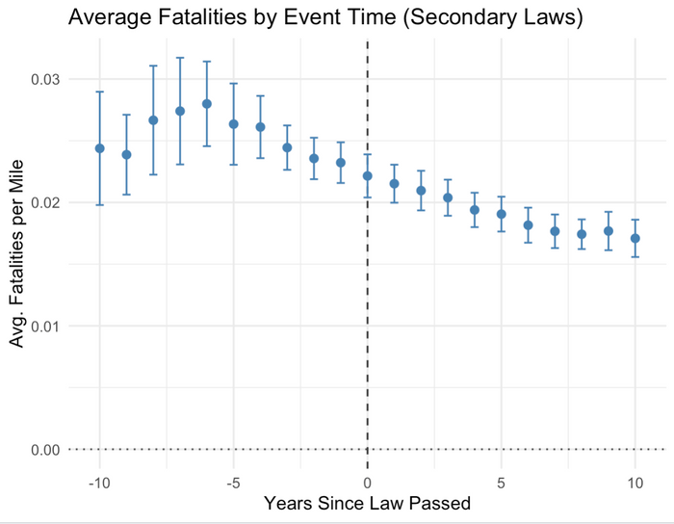
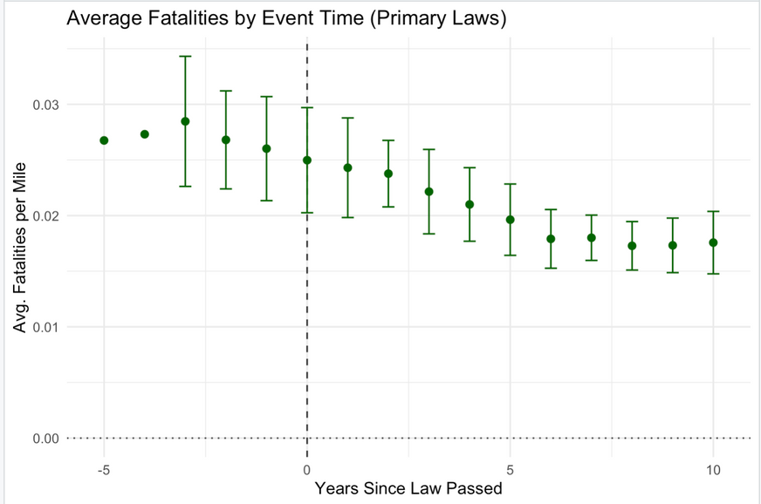
SEATBELT USE AND FATALITIES: TRENDS AND DISTRIBUTIONS
The histogram shows the distribution of seatbelt usage rates across all state-year observations from 1984 to 1997.
The DiD plot for secondary enforcement laws shows a clear decline in average traffic fatalities per mile following law adoption.
The DiD plot for primary enforcement laws also shows a decline in fatalities over time.

Slide 7
RESULTS
KEY ESTIMATES:
ROBUSTNESS ACROSS SPECIFICATIONS (SECONDARY):
Conclusion: Seatbelt laws, especially secondary enforcement, significantly reduce fatalities when endogeneity is properly addressed.
Enforcement | Coefficient | SE | p-Value | First Stage F-Stat
Secondary | -0.099 | 0.055 | 0.074 | 53.4
Primary | -0.154 | 1.94 | n.s. | 32.0
Specification | Naïve OLS | FE | FE + Controls | 2SLS (Base)
Secondary | -0.248 | -0.036 | -0.043 | -0.099

Slide 8
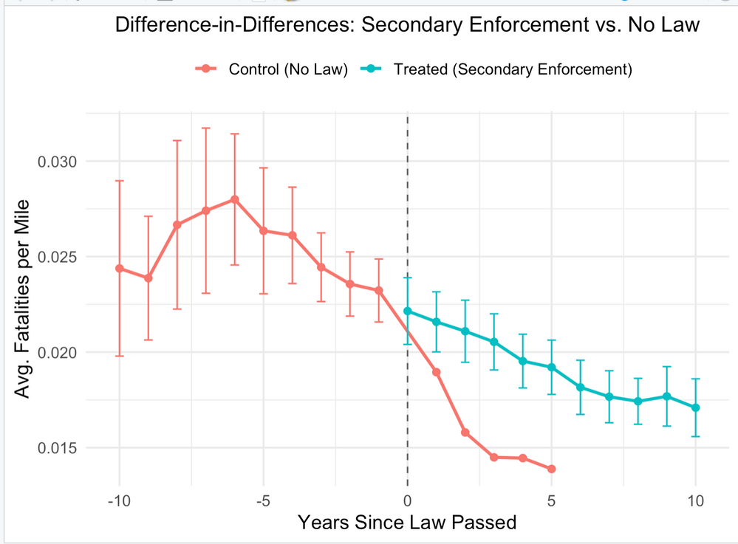
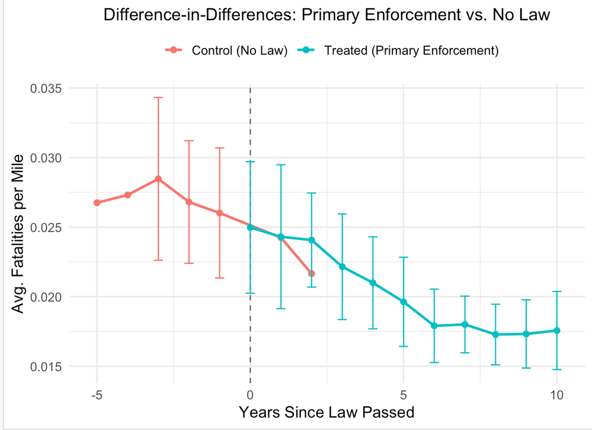
DIFF-IN-DIFF GRAPH
Your paragraph text

Slide 9
Endogeneity of seatbelt use:
Addressed by using 2SLS, instrumenting seatbelt usage with enforcement law type (primary/secondary), which varies exogenously at the state-year level.
Measurement error in seatbelt usage data:
Mitigated by incorporating multiple control variables and focusing on relative changes over time with state and year fixed effects to reduce bias from reporting inconsistencies.
Small sample size for primary enforcement states:
Acknowledged as a key limitation. While the coefficient direction aligns with expectations, the lack of statistical significance is attributed to limited data, not lack of effect.
Omitted variable bias:
Controlled for observable policy variables like alcohol laws, speed limits, income, and used state and year fixed effects to absorb unobserved heterogeneity across time and geography.
LIMITATIONS
What are the limitations to our model and how do we address these issues?

Slide 10
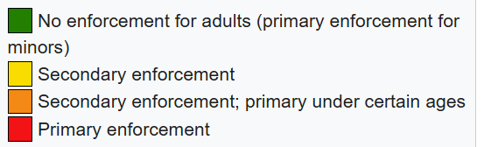
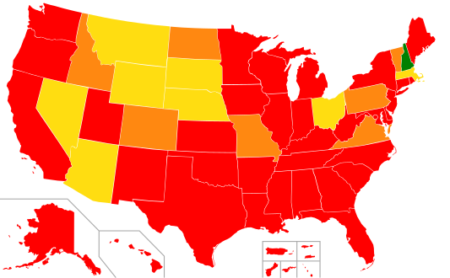
CONCLUSION & FINDINGS
Negative Point Estimate
2SLS coefficient: –0.154 → suggests primary laws lower fatalities
Direction aligns with theory and broader evidence
Why Not Statistically Significant?
Only 87 state-year observations with primary laws in 1983–1997
Small sample → large standard error (SE = 0.194) → p > 0.10
Real-World Context
Today, most U.S. states have primary enforcement (see modern map)
Widespread uptake reflects confidence in life-saving impact
Key Takeaway
Direction of the effect is as expected
Lack of significance driven by limited data, not policy ineffectiveness
With more recent data, we’d expect a larger, statistically robust estimate

Slide 11

THANK YOU!

